Slide 1
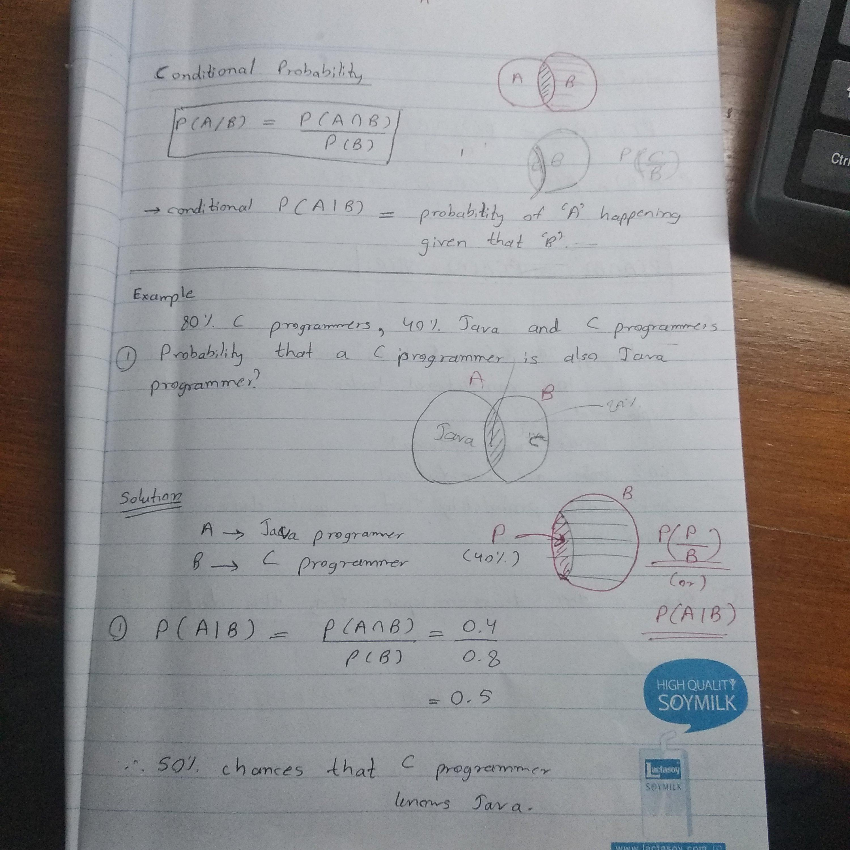
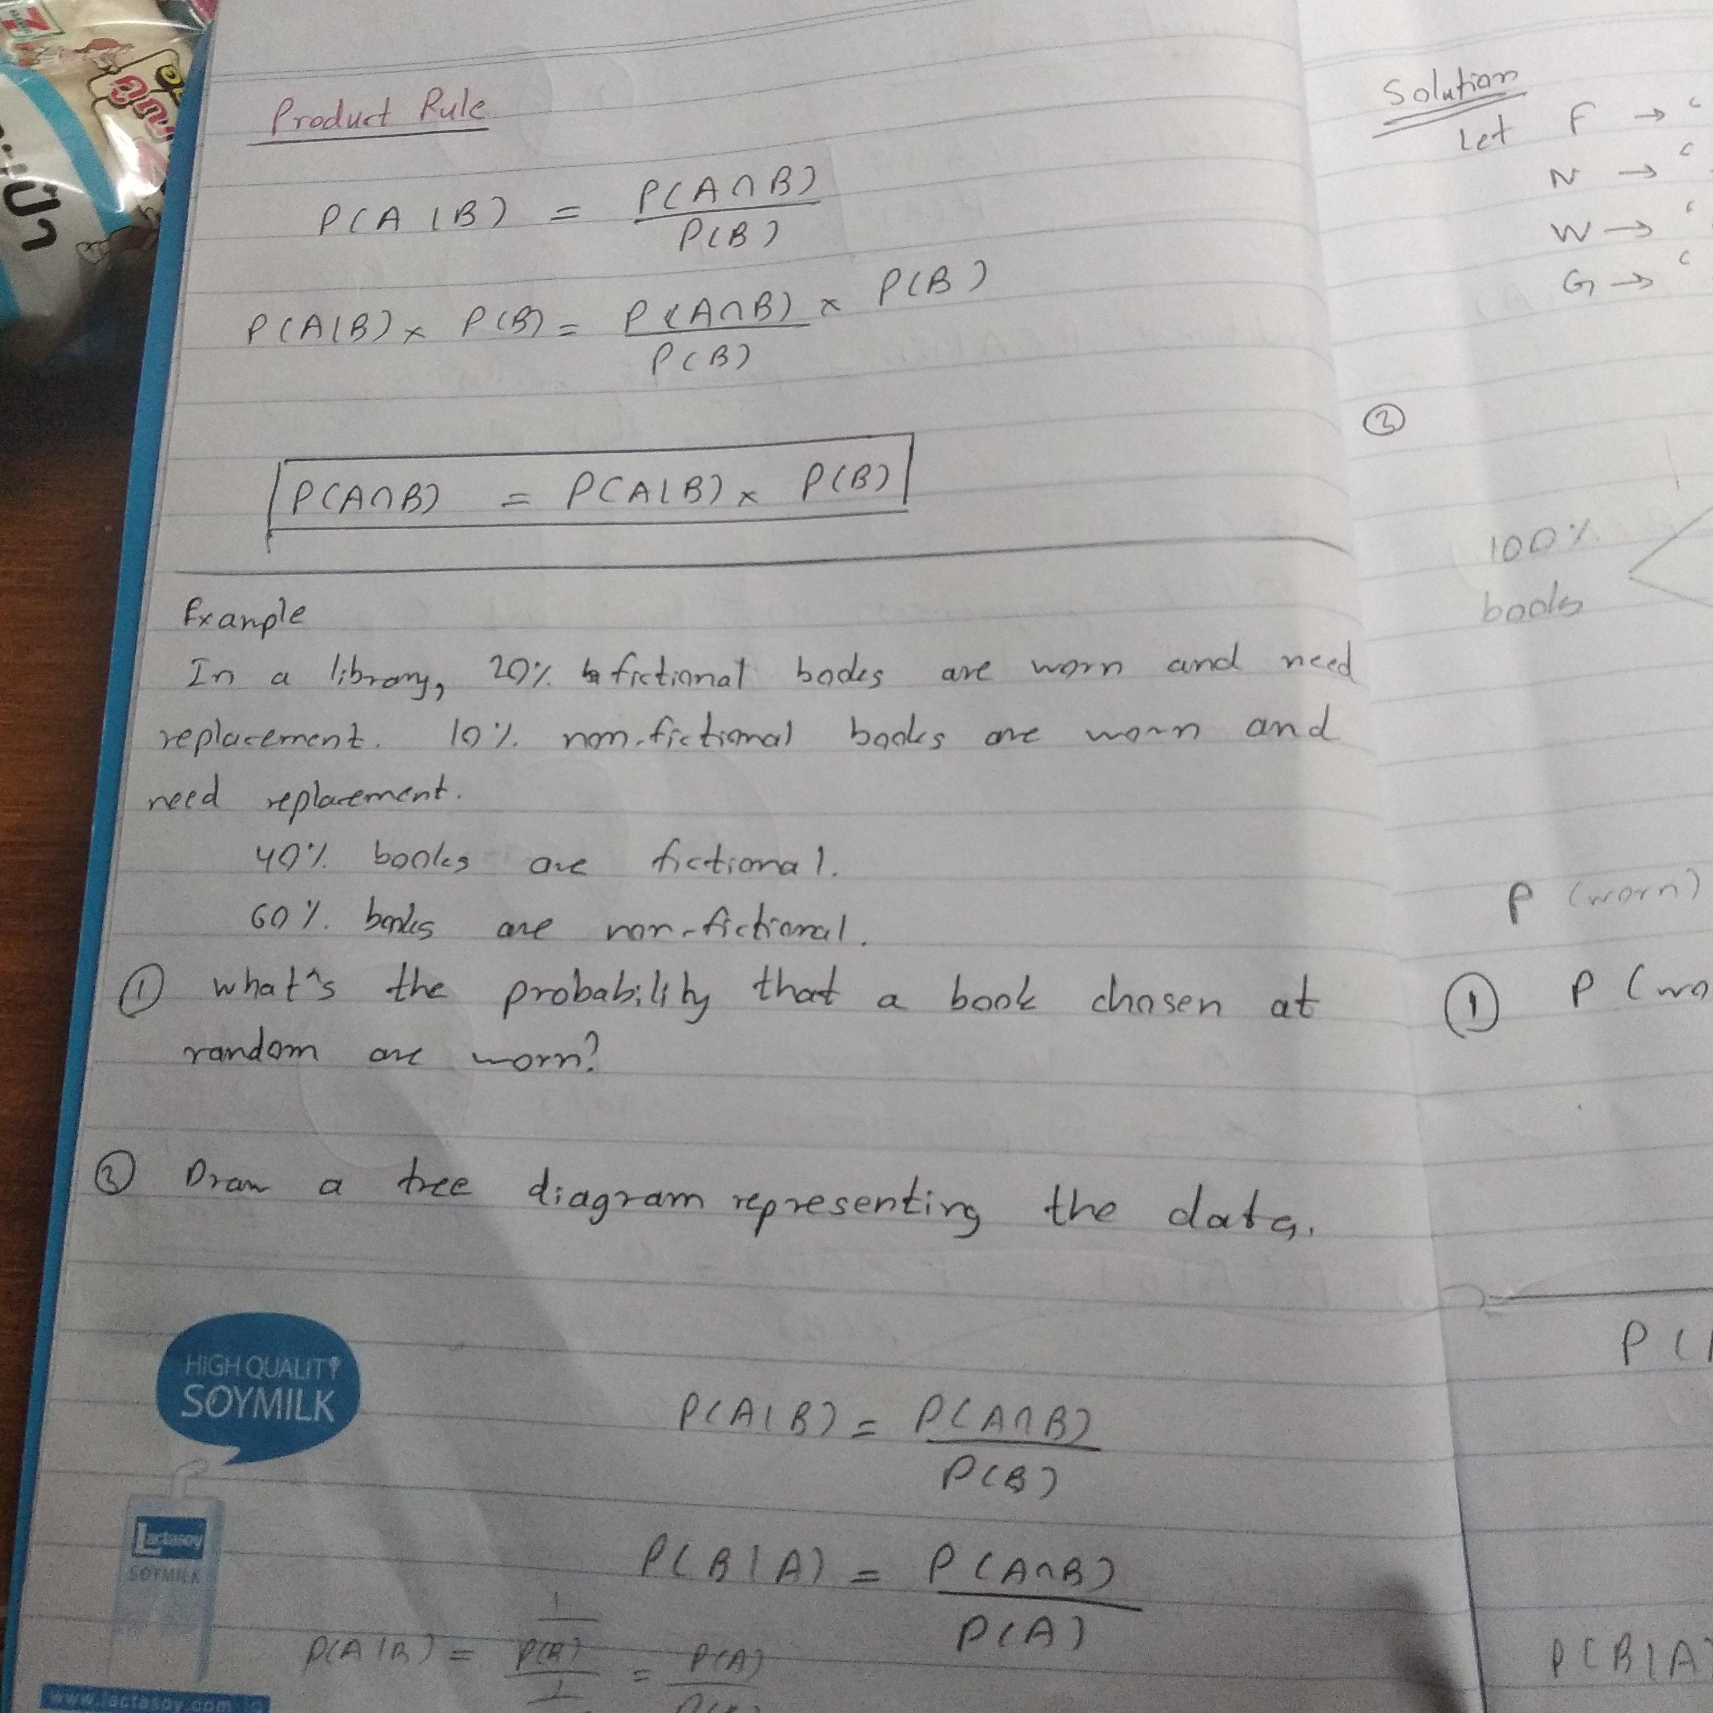

Slide 2
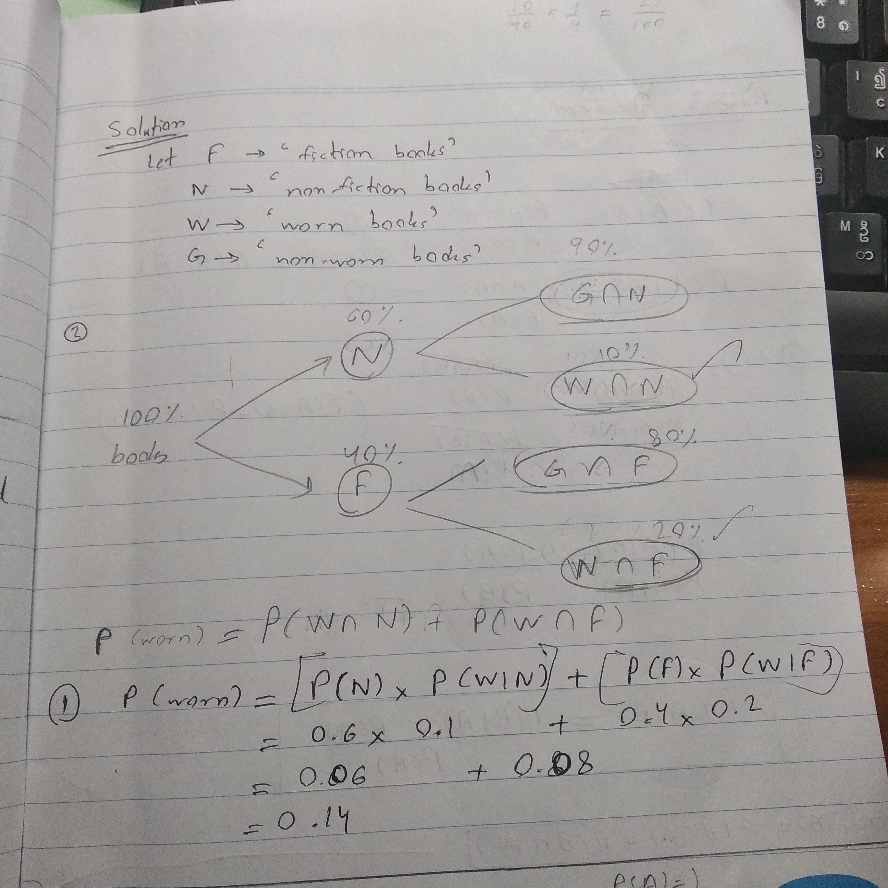

Slide 3
Binomial distribution
The registration office claimed that 80% of all students are satisfied to the service. In order to test this claim, a random sample of 10 students is selected
Find the probability that exactly 6 students are satisfy
Find the probability that at least 7 students are satisfy
Find the probability that 4 or less students are satisfy
# binom.pmf(x, n, p) binom.cdf(x, n, p)
from scipy.stats import binom
binom_question_2_a = binom.pmf(6,10,0.8)
print (binom_question_2_a)
binom_question_2_b = 1 - binom.cdf(6,10,0.8)
print (binom_question_2_b)
binom_question_2_c = binom.cdf(4,10,0.8)
print (binom_question_2_c)
Poisson distribution
A retail store claimed that the average number of customers will enter to the store at 5 customers per hour.
Find the probability that 3 customers will enter to the store in 1 hour
Find the probability that at most 10 customers will enter to the store in 1 hour
Find the probability that no customers will enter to the store in 30 minute
# poisson.pmf(x, n) poisson.cdf(x, n)
from scipy.stats import poisson
Poisson_question_2_a = poisson.pmf(3,5)
print(Poisson_question_2_a)
Poisson_question_2_b = poisson.cdf(10,5)
print(Poisson_question_2_b)
Poisson_question_2_c = poisson.pmf(0,2.5)
print(Poisson_question_2_c)

Slide 4
Uniform distribution –Python
uniform.cdf( x , location , interval)
Example: The weight of a certain species of frog is uniformly distributed between 15 and 25 grams. What is the probability that the frog weight between 17 and 19 grams?
from scipy.stats import uniform
x1 = uniform.cdf(17, 15, 10)
x2 = uniform.cdf(19, 15, 10)
prob = x2 -x1; print(prob)
norm.cdf( x , mean , standard deviation)
Example: Finding the proportion of self-employed who work between 50 and 70 hours a week. Assume time is normally distributed with mean at 45 hours and standard deviation at 15 hours.
from scipy.stats import norm
x1 = norm.cdf(50, 45, 15)
x2 = norm.cdf(70, 45, 15)
prob = x2 -x1; print(prob)

Slide 5
Weighted mean and variance
Suppose the quiz score of 30 students are collected as the following table
Score
25
30
Count
8
4
35
40
45
50
3
4
5
6
Find the average and standard deviation of 30 students
data = [25, 30, 35, 40, 45, 50]
weights = [8, 4, 3, 4, 5, 6]
import math
import numpy as np
def weighted_avg_and_std(data, weights):
average = np.average(data, weights=weights)
variance = np.average((data -average)**2,weights=weights)
return(average,math.sqrt(variance)) print(weighted_avg_and_std(data, weights))

Slide 6
Central Limit Theorem code
Question
Population = 10000
Sample = 100
Sample size = 1
import numpy.random as np
import seaborn as sns
import matplotlib.pyplotas plt
population_size= 10000
Population = np.random(10000)
number_of_sample= 100
sample_means= np.rand(number_of_sample)
sample_size= 1
c = np.rand(number_of_sample)
for i in range(0, number_of_sample):
c = np.randint(1,population_size, sample_size)
sample_means[i] = population[c].mean()
plt.subplot(1, 2, 1)
plt.xticks(fontsize= 14)
plt.yticks(fontsize= 14)
sns.distplot(sample_means, bins=int(180/5), hist=True, kde=False)
plt.title(‘Histogram of Sample mean’, fontsize= 20)
plt.xlabel(‘Sample mean’, fontsize= 20)plt.ylabel(‘Count’, fontsize= 20)
plt.subplot(1, 2, 2)
plt.xticks(fontsize=14)
plt.yticks(fontsize=14)
sns.distplot(sample_means, hist=False, kde=True)
plot.title(‘Density of Sample mean’, fontsize= 20)
plot.xlabel(‘Sample mean’, fontsize= 20)
plt.ylabel(‘Count’, fontsize= 20)

Slide 7
One population mean with known population (Z –Test) with python
Example
The articles in Journal of Marketing, studied the satisfaction of video games and it found that the mean of customer satisfaction is 42.95 from 100 customers. Calculate 95 percent confidence interval for population mean and assume the population variance is 5.
import numpyas np
from scipy.stats import norm
mean = 42.95
stdev= np.sqrt(5)
n = 100;confidence = 0.95
z_crit= np.abs(norm.ppf((1 –confidence) / 2))
print((mean –stdev*z_crit/ np.sqrt(n), mean + stdev*z_crit/ np.sqrt(n)))

Slide 8
One population mean with unknown population (T –Test) with python
Example
Suppose the score of university student in midterm examination are 15, 18, 19, 20, 23, 22, 16, 25. Calculate 90 percent confidence interval midterm examination.
data = [15, 18, 19, 20, 23, 22, 16, 25]
import numpy as np
import statistics as sta
from scipy.stats import t
mean = np.average(data)
stdev= np.sqrt(sta.variance(data))
n = len(data)dof= len(data) –1; confidence = 0.9
t_value= np.abs(t.ppf((1 –confidence) / 2, dof))
print(mean –stdev*t_value/ np.sqrt(n), mean + stdev*t_value/ np.sqrt(n))

Slide 9
One population proportion with python
Example
A national bank would like to improve customer satisfaction. A key measure of customer satisfaction is the response on a scale of 1 to 5 to the question. Suppose that a random sample of 400 customers is collected and 280 customers with a response of 4 or 5 which representing “customer delight”. Find a 95% confidence interval for a true proportion of customer
from statsmodels.stats.proportionimport proportion_confint
Interval = proportion_confint(280, 400, method = ‘normal’)
print(interval)

Slide 10
Slide 7, 8, 9 Note
One population mean with known population (Z –Test)
N > 30 (more accurate) (have a large impact of data set) (closer to normal distribution)
One population mean with unknown population (T –Test)
N < 30 (less accurate) (small amount of data set) (far from normal distribution)
One population proportion with python
More than one data set

Slide 11
Linear model
•Correlation
Correlation by using Python
import numpy as np
x = np.array([10, 11, 12, 13, 14, 15, 16, 17, 18, 19])
y= np.array([2, 1, 4, 5, 8, 12, 18, 25, 96, 48])
r = np.corrcoef(x, y)
print(r)
import scipy.stats
r1 = scipy.stats.pearsonr(x, y)
print(r1)
Scatterplot by using Python
import numpy as np
import seaborn as sns
x = np.array([10, 11, 12, 13, 14, 15, 16, 17, 18, 19])
y= np.array([2, 1, 4, 5, 8, 12, 18, 25, 96, 48])
sns.scatterplot(x, y);
sns.regplot(x, y);
Meaning of Correlation
• It is a measure of relationship between two variables
• The value of correlation ranges between -1 and 1
• The greater the value, the stronger the relationship

Slide 12
Linear Model by using Python
import numpy as np
from scipy import stats
x = np.array([10, 11, 12, 13, 14, 15, 16, 17, 18, 19])
y= np.array([2, 1, 4, 5, 8, 12, 18, 25, 96, 48])
slope, intercept, r, p, std_err= stats.linregress(x, y)
print(slope)
print(intercept)
print(r)

